Slide 1
Office for Exceptional Children Gifted Stakeholder Meeting
Office for Exceptional Children ∙ September 2022

Slide 2
Welcome and Introductions
Thank you for attending!
We appreciate your time and feedback
Introductions

Slide 3
Group Norms
Identify yourself before speaking
One person speaking at a time
Raise hand to speak or wait for the facilitator to address you
Listen actively while others are speaking

Slide 4
Purpose and Expectations
Engage stakeholders in discussions regarding Ohio Administrative Code (OAC) 3301-51-15 Operating Standards for Identifying and Serving Students Who are Gifted
Obtain stakeholder feedback on current rule and proposed changes
Department reviews all feedback prior to public comment
Notes:
Ohio legislation requires these rules undergo a review by the Ohio Department of Education and stakeholders every five years. Department staff is in the process of conducting the review of these standards.​
​
Public Comment is slated for November (CHECK THIS!!!!)
​
Stakeholders will receive multiple electronic communications throughout the public comment period. A GovDelivery notification will be sent out as a reminder of the public comment period. ​
​
An article on the rule revision will be included in the department’s electronic newspaper, EdConnection. A story will run the day the comment period begins and a reminder article will run in the ‘Deadline and dates’ section throughout the public comment period.

Slide 5
Document Viewing
Comments explain edits
Proposed changes
Underlined if new or moved
Crossed out if removed
Notes:
You will see two different rule documents:​
Original rule​
Rule with proposed changes ​
​
​
Explain color highlights​
Within the highlighted language, proposed changes are marked in two ways.​
If the language is new, the text will be blue and underlined. ​
If the language is being removed from the rule, the text will be red and will have a strike-out line through it.

Slide 6
Ohio Administrative Code 3301-51-15
Rule: 3301-51-15 Operating Standards for Identifying and Serving Students Who are Gifted

Slide 7
Overview of 3301-51-15
Establishes the minimum requirements for identifying and serving students who are gifted
Defines and establishes the minimum requirements for gifted education personnel, including professional development for designated providers of gifted services

Slide 8
Overview of 3301-51-15 Continued
Defines and clarifies the requirements for public school districts regarding gifted identification plans, gifted education policies, and gifted service plans
Establishes and defines the role of the Gifted Advisory Council

Slide 9
Proposed Revisions
Removed duplicative language found in Ohio Revised Code
Added clarifying language throughout
Revised some requirements for whole grade screenings, written education plans, and gifted education professional development
Notes:
Many changes here – Many paragraphs duplicated ORC 3324 were removed and replaced with references to the Ohio Revised Code
Clarifying language was added throughout
Several requirements were revised, including whole grade screenings, certain requirements for written education plans and gifted education professional development

Slide 10
Proposed Revisions Continued
Added local identification, talent development, minimum standards for gifted education complaint process and acceleration
Added implementation of district gifted service plan
Removed Innovative Gifted Services and “No Service” letter
Notes:
There are several new additions to the rule, including new paragraphs. Language was added to increase the flexibility for gifted identification based on a district’s locally developed identification plan. In addition a paragraph was included for talent development and acceleration, as well as minimum standards for gifted education complaints.
In addition, the rule adds the implementation of a district gifted service plan per ORC 3324.07 (A)
Some things were removed from the rule, including innovative gifted service proposals and the requirement for districts to provide a “no service” letter for students who are identified gifted but do not receive gifted services.

Slide 11
Facilitated Discussion Questions
Is the language in the rule clear and concise? If not, what changes are necessary?
Is the language in the rule understandable? If not, what changes are necessary?
How do the strike outs from the Ohio Revised Code effect the language of the rule? Does it make it difficult to understand? If so, what changes are necessary?
What items or topics are missing in the rule?
What guidance would help districts and families understand or implement this rule?
What additional comments or concerns should we consider?

Slide 12
Current Revision Timeline
May to Aug. 2022
First Draft
Dec. to Jan. 2023
Rule Revisions
April to May 2023
State Board
Dec. 2021 to
April 2022
Recommendations
Sep. to Nov. 2022
Stakeholder Engagement
Feb. to March 2023
Public
Comment
Summer 2023
Agency Review & Filing
Notes:
This is our current timeline for the revision process – although these dates are subject to change as we move through the process. Some stages have required timelines (public comment periods, etc.) and other stages might need more time, especially as we move through the state board process. Right now, we are in the stakeholder engagement phase. After these stakeholder engagement meetings, we will hold public comment - you will also be able to participate in the public comment phase.

Slide 13
Questions

Slide 14
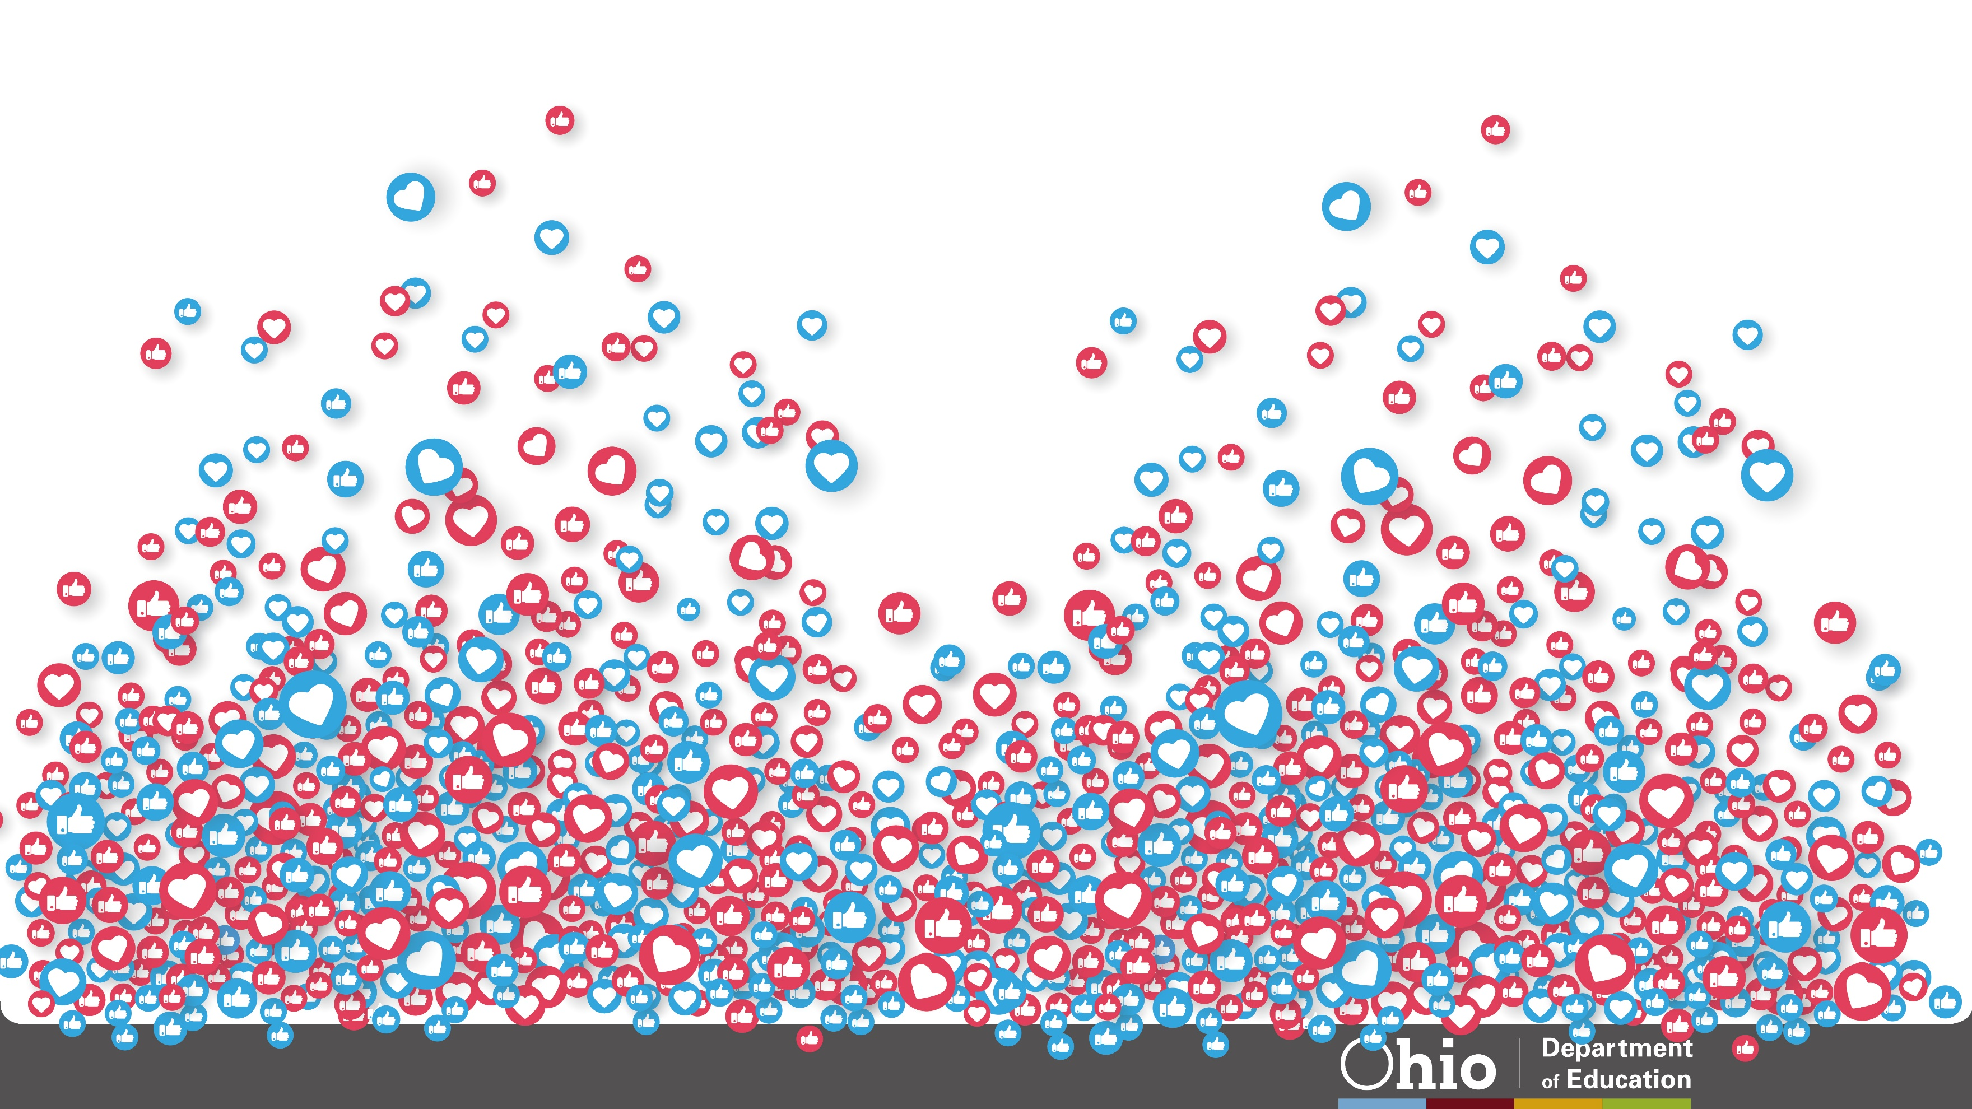
@OHEducation

Slide 15
Share your learning community with us!
#MyOhioClassroom
Celebrate educators!
#OhioLovesTeachers

