Slide 1
Gifted Advisory Council
April 2023

Slide 2
Welcome

Slide 3
Roll Call

Slide 4
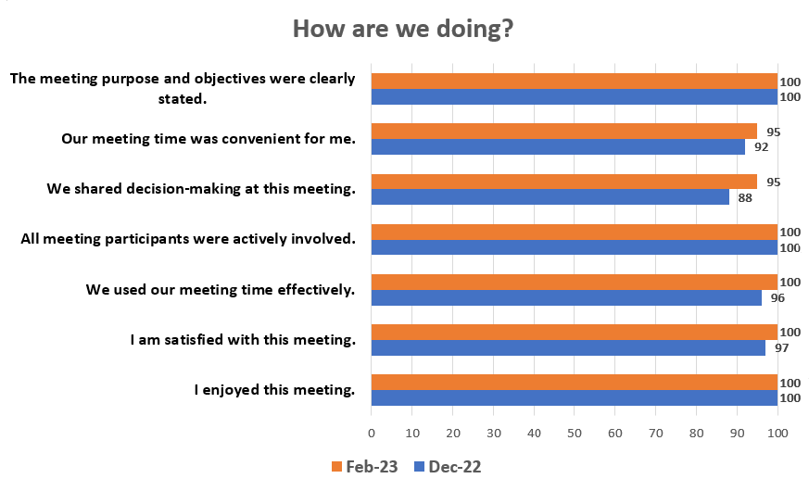
February Feedback

Slide 5
Meeting Norms
Pausing
Paraphrasing
Asking Questions
Putting Ideas on the Table
Providing Data
Paying Attention to Self and Others
Presuming Positive Intentions

Slide 6
Agenda
February Meeting Feedback
Approve February Minutes
Public Comment
Chair-Elect Vote
Strategic Plan Update/Status
Workgroup Breakouts
Lunch
Workgroup Breakouts continued
Debrief, Next Steps, Closing Comments, FY24 Dates

Slide 7
What aspects of this meeting were particularly good?
I truly enjoyed having the guest presenter tell us about our state & trends data. His perspective on creating equity in our programs has been very insightful.
I enjoyed the rich discussion regarding local norms. I feel much more informed about this concept.
I enjoyed the working sessions after lunch in our strategic plan groups. As a new member it was good to collaborate and get to know our group members.
I like hearing others' perspectives about how their districts handle gifted programming.
The presentation from Dr Peters was very useful in helping me understand the potential benefits (but also limits) of different kinds of norms as applied to Ohio. I appreciated his honesty about where school norms could make a difference and where they probably won't have much of an effect. And also about the likely consequences for instructional strategies. It was very illuminating!
The passion and expertise in the room. The opportunity to think deeply about complex choices.

Slide 8
What aspects of this meeting need improvement?
I think we need more time to work in our focused groups.
Not sure we need to break for lunch if we are only meeting for four hours. Would rather do a working lunch and have more time in groups
I thought the meeting was great, but it would be fantastic to have projectors for each subcommittee or at least some large chart paper to work with.
Clearer direction in the small groups.
I like a short break for people to grab food and then have more working group time.

Slide 9
Do you have any suggestions or additional comments about this meeting?
I guess with the extension of the revised code, adding to the focused group time would be nice. Maybe even have our focused work time & then have more time to understand what other groups are doing and have the ability to gather & share feedback among all groups
It may be worthwhile to reach out to some of the former GAC members about re-joining committee work. Some that I have spoken with did not know it was an option to continue to work on committees.
Perhaps since there are 4 meetings - we could hold them regionally and maybe have council members host at their school/district.
Keep up the good work! Maybe we can think more about moving to three meetings instead of four next year since we spend more time driving than actually meeting.
I think the 4-hour format, 4 times a year is as optimal as possible.
Disappointed that the timeline has been delayed 6 months.

Slide 10
Approve February 2023 Minutes

Slide 11
Public Comment

Slide 12
Chair Elect Vote

Slide 13
Strategic Plan Update/Status

Slide 14
Revised Target Deadlines
September 2023:
Survey Release
October 2023:
Stakeholder Townhalls
November 2023:
Review Stakeholder Feedback
December 2023:
Draft Workgroup Recommendations

Slide 15
Revised Target Deadlines, continued
February 2024:
Finalize Recommendations
March 2024:
Department Begins Drafting Plan
April 2024:
Council Review and Feedback
May 2024:
Final Draft

Slide 16
Workgroup Breakouts

Slide 17
Workgroup Assignments
Equitable Identification Practices | Highly Effective Student Supports and Services | Job Embedded Professional Development
Donna Ford | Brad Brunswick | Maggie Gunnerson
Christina Gulley | Jennifer Detmar | Dianna Jones Manley
Jackie Rausch | TK Kuykendall | David Moss
Sylvia Rimm | Jeanne Osterfeld | Kathleen Poe
Amy Rossler | Sara Watson | Carrie Sanchez
Ann Sheldon | Brad Morris | Elizabeth Deuer
Carissa Spitzer | Denise Cooley | Kylie Duskey
Frank Sansosti | Katie Baker | Kristin Barker
Kathleen Terapak | Tiffany Buchanan | Denise Toler
Heidi Bollin | Toni Lindblade | Deborah Glynn
Jenni Ferro | Thomas Lish-Brown | Jennifer Kopcak
Christine Reeves | Kimberly McCormick

Slide 18
Workgroup Guiding Questions
What are the identified best practices based on research?
Which of these do you see that are currently being successfully implemented in Ohio?
What are the opportunities for change?
Which of these opportunities for change should be prioritized?

Slide 19
Lunch

Slide 20
Workgroup Breakouts, continued

Slide 21
Debrief

Slide 22
Next Steps VPA Rubric Content Area Experts Closing Comments Proposed Meeting Dates – 4 times a year, 10:00 a.m. – 2:00 p.m. • September 20, 2023 • December 6, 2023 • February 28, 2024 • April 24, 2024 Adjourn

Slide 23
@OHEducation

