Slide 1
USDA Foods Program 101: Program Basics
Christine Farmer and Holly Prater
Office for Child Nutrition – March 2018

Slide 2
United States Department of Agriculture
Ohio Department of Education Office for Child Nutrition
Schools participating in the National School Lunch Program
Residential Child Care Institutions participating in the National School Lunch Program
Summer Food Service Program sponsors
Charitable Institutions
Notes:
How the Program Works
The USDA foods program is a federally operated/funded program that is administered at the state level (ODE) through the Office of Child Nutrition.
The Ohio Department of Education, Office for Child Nutrition, in partnership with the United States Department of Agriculture is responsible for the distribution of USDA foods.
Who is eligible to receive USDA foods?
All public and nonpublic schools participating in the National School Lunch Program
All Residential Child Care Institutions participating in the National School Lunch Program
All Summer Food Service Program sponsors
Charitable Institutions (eligible only for unallocated surplus, when available)

Slide 3
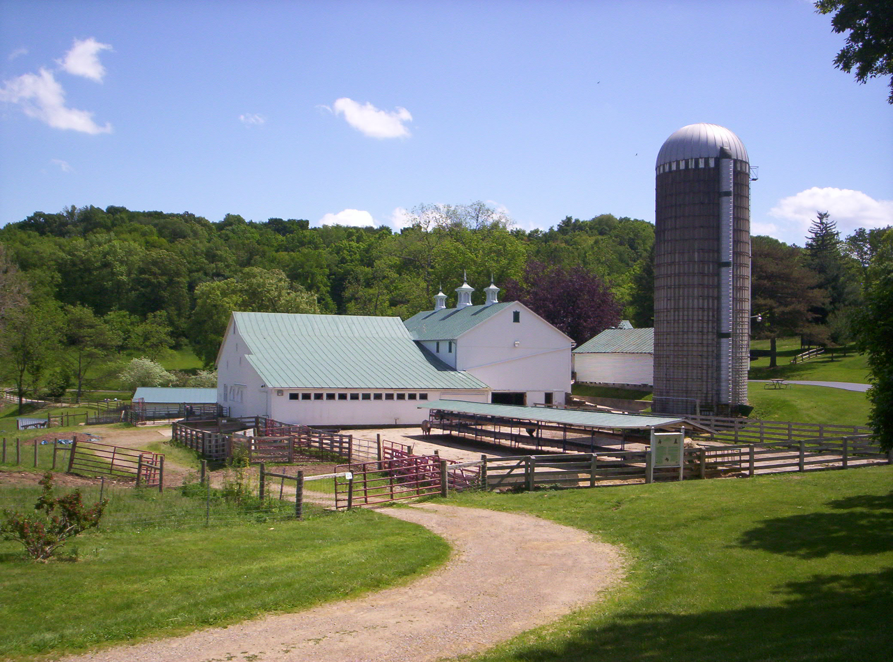
What are USDA Foods?
Foods that are purchased by the USDA from the American agricultural industry to support nutrition assistance programs.
Notes:
USDA Dual Mission
USDA purchases foods from farmers, ranchers, dairymen, and fishermen to enable them to earn a fair profit on their products and to support the American agricultural industry.
To improve the health and well-being of the population
The USDA food distribution program’s mission is to strengthen the Nation’s nutrition safety net by providing food and nutrition assistance to school children and families: and support American agriculture by distributing high quality, 100 % American-grown USDA foods.

Slide 4
Use of USDA Foods
USDA Foods may be used in the meal preparation of any meal service that is operated by a school or institution under the nonprofit school food service account.
Notes:
USDA foods can be used for any meal service that is operated under a nonprofit school food service account.
Examples: School Breakfast Program, After School Care Snack Program, a la carte sales and meals and snacks in Residential Child Care Institutions

Slide 5
What is PAL?
Notes:
The state receives entitlement dollars from the USDA, which is then distributed to schools as PAL (planned assistance level)
However CATS is slightly outdated, it still appears as Entitlement through out the system. We want to make sure we are all using the correct terminology and CATS will catch to us!

Slide 6
How is the Planned Assistance Level (PAL) funding determined for each sponsor?
Calculation is based on the number of reimbursable lunches served in the previous school year.
Notes:
So how much money or Planned Assistance dollars does your school get to spend on USDA foods?
Planned Assistance Level Dollars
The dollar amount for each school district is calculated by multiplying the total number of lunches served in the prior year by the USDA entitlement rate (meal rate established by the USDA).
The entitlement rate established by the United States Department of Agriculture (USDA) is currently 33 cents, per lunch under the National School Lunch Program for this School Year, 2017-2018.
NOTE: Once a sponsor has received USDA foods equal to or greater than their annual allotment, only unclaimed surplus foods will be offered for the balance of the program year.

Slide 7
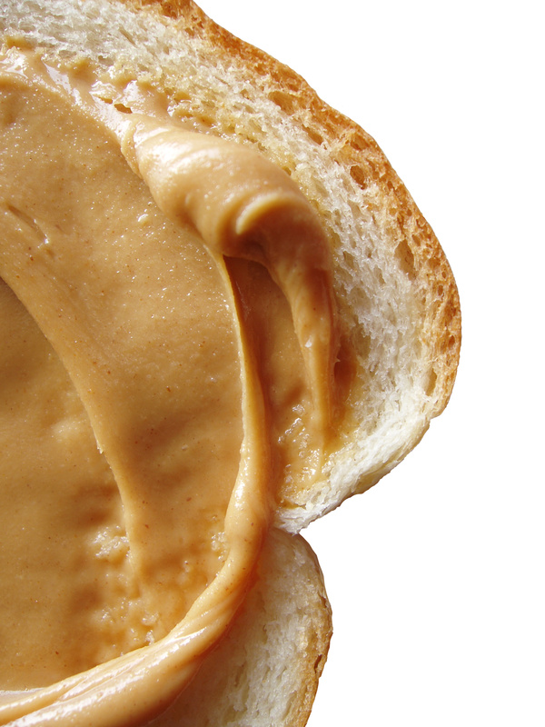
PAL: Breakfast and Snacks
Breakfast and after school care snack data is not included in the PAL calculation. However, USDA Foods may be used for these meals.

Slide 8
USDA Foods Ordering Strategies
The 20% Rule
Divide-by-Nine Approach
Notes:
So, how much USDA Foods should you order?
The 20% Rule: According to the USDA, USDA Foods are expected to account for about 20% of the annual lunch food budget of each school.
Divide-by-nine approach: Since schools receive nine USDA Foods ordering periods in a school year, they may choose to apply the divide by nine rule, This is essentially taking the total amount of PAL dollars for the year and dividing it by 9, so about 1/9th of their PAL is used for each monthly order. This ensures that you use all your PAL to your benefit.
This should be used as a guide, if money is transferred or diverted for other food purchases (Direct diversion or USDA DOD Fresh) that PAL should not be used in the calculation.
Your goal should be to use 105% of PAL by the end of the school year. For planning, we strongly suggest having 70% spent by January.

Slide 9
Ways to use your PAL dollars
Demand Ordering
Direct Diversion
USDA Department of Defense Fresh Fruit and Vegetable Program (FFAVORS)

Slide 10
What is Demand Ordering?
Notes:
What is Demand Ordering?

Slide 11
Allows schools to
pre-order USDA Foods before the school year begins and to plan their usage during the school year.
Notes:
Demand ordering is the process of schools pre-ordering USDA food items prior to the beginning of a school year

Slide 12
Objectives of Demand Ordering
Maximize Entitlement
Minimize Inventory
Notes:
Demand Ordering’s purpose is to:
1. Maximize PAL used by schools to help offset food costs by emphasizing the use of PAL dollars for direct diversion ( we will talk about direct diversion in a moment), also the USDA Department of Defense Fresh Fruit and Vegetable Program, as well as the brown box and processed items delivered through the State contracted warehouses
2. Help minimize inventory levels at state-contracted warehouses
3. The State may plan and place orders in advance to the USDA and food processors without over ordering.
Overall: Reduce costs and increases efficiency

Slide 13
Monthly Order
Notes:
Delivery dates are listed
Allocated is the amount that your agency preordered through the demand order survey.
If there is any unclaimed surplus it will show up
Please note that the 60 day column will no longer show next year.

Slide 14
Charges Associated with Demand Ordering
The “Entitlement Value” of a USDA Food item is charged against your PAL balance.

Slide 15
Demand Ordering Unclaimed Surplus
Unclaimed surplus items do not draw down your PAL dollars.
Notes:
Beginning in SY 18/19 Bonus items will be referred to as “unclaimed surplus”
Unclaimed surplus does not draw down your PAL.

Slide 16
What is Direct Diversion?
Notes:
So, What is Direct Diversion?

Slide 17
Direct diversion allows a sponsor to request raw USDA Foods to a processor for further processing.
Notes:
Direct diversion is the process that allows a sponsor to send USDA Foods to a processor.
The USDA Food is then to be utilized in product(s) according to the sponsor’s specifications
Example: flour into breadsticks
Provides the sponsor the opportunity to use PAL dollars for the purpose of direct diverting pounds of a raw USDA Food item to a processor.
Once this is done, you can order the finished end product(s) from the processor. The processor will provide a rebate or discount based on the value of the raw USDA Food used to produce the finished end product.

Slide 18
Benefits of Direct Diversion
Converts USDA Foods into more useable items.
Examples: chicken converted to chicken patties or flour converted to bread sticks.
Provides schools with a quality product at a cost less than full retail price.

Slide 19
What is the USDA Department of Defense Fresh Fruit and Vegetable Program?

Slide 20
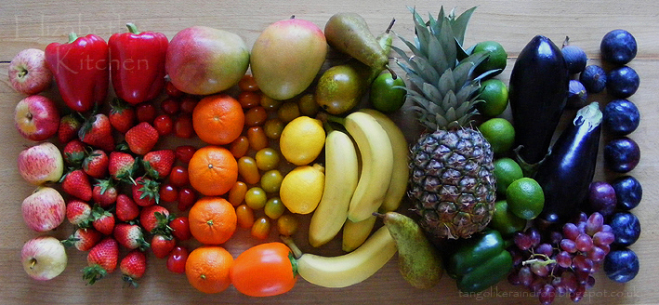
The USDA Department of Defense Fresh Fruit and Vegetable Program (USDA DoD Fresh Program)
Provides the opportunity to allocate PAL dollars for ordering fresh fruit and vegetables.
Notes:
The USDA Department of Defense (USDA DOD) Fresh Fruit and Vegetable Program provides you the opportunity to use PAL dollars for the purpose of ordering fresh fruit and vegetables through the Department of Defense.
Also known as FFAVORS
Throughout the school year, as you order from FFAVORS, you may run low on funds. You can submit a request to transfer additional PAL dollars to your FFAVORS account. Or you may decide you would like to participate in this program and submit an initial request.

Slide 21
Benefits of the USDA DoD Fresh Fruit and Vegetable Program
Flexibility
High Quality
Consistency
Variety
Local

Slide 22
Using the Commodity Allocation Tracking System (CATS)
Notes:
This is our last section and this is where CATS comes in…
This system is for you as sponsors, us in our office:
This is where you will be:
Ordering
Managing entitlement
Getting your invoices
Completing surveys

Slide 23
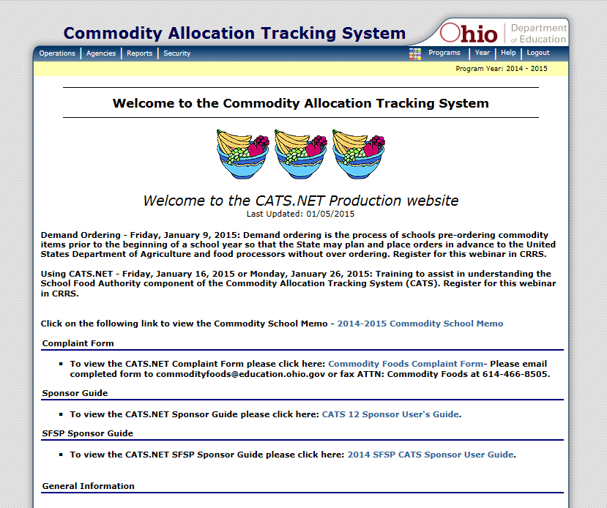
The USDA Foods Allocation and Tracking System Information
Notes:
CATS Splash page – conveys important program information
Displayed on the first page after you log in and click on the Food Distribution Program
You may see information on
Recalls
Food Safety Alerts
System Information or changes
General ordering information

Slide 24
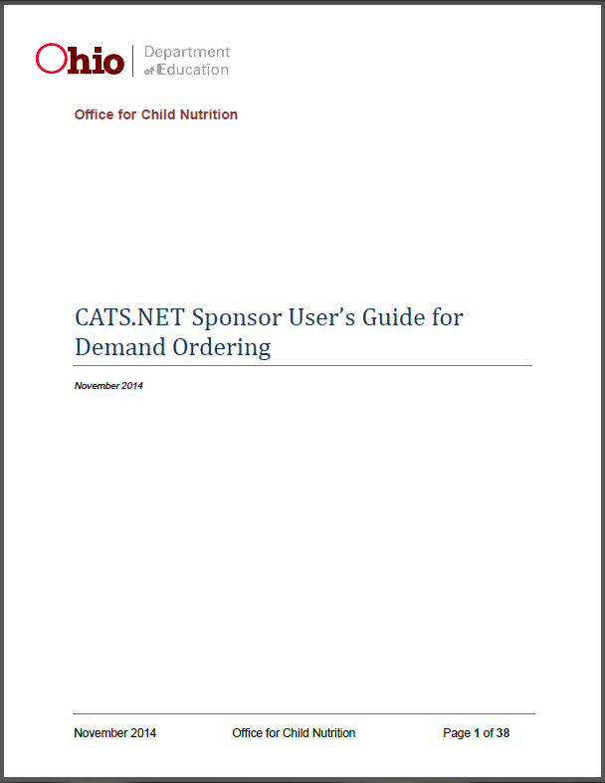
Sponsor User’s Guide for Demand Ordering
To access the complete guide, search “CATS” on ODE’s
website, login to CATS, or click here.
Notes:
Stored on the ODE website, CATS page (available on splash page)
URL:
http://education.ohio.gov/Topics/Other-Resources/Food-and-Nutrition/CATS-Commodities-Allocation-Tracking-System

Slide 25
Surveys and Ordering
Notes:
Now that you know the ways that you can spend your PAL, lets look into how you order!

Slide 26
USDA Food Surveys
There are three types of surveys:
USDA Foods Demand Ordering
Direct Diversion
USDA Department of Defense Fresh Fruit and Vegetable Program
Notes:
Surveys allow the USDA Foods Team to gather information regarding needs and future orders of various USDA food items, this does not include Direct Diversion Survey.
A direct diversion survey orders USDA food items and diverts them to a processor chosen by the sponsor/school.

Slide 27
Demand Ordering Process
Determination of offered food items by OCN
Demand Ordering Survey available
OCN determines quantities ordered and arranges delivery to warehouses
Notes:
The Office for Child Nutrition determines which products are to be offered to the sponsors on a demand ordering basis for the upcoming school year
Remember that your goal is to use 105% of your PAL
The Office for Child Nutrition sets up the Demand Ordering Survey for the upcoming school year and makes the survey available to the schools. When you submit your survey, you are committing to receiving these products. We are moving to a request driven system. In which, what you order is what you receive. If you do not include a certain item in your survey, it may not be available to order through out the year.
MOST IMPORTANTLY: IF YOU DO NOT COMPLETE THIS SURVEY THERE WILL BE NO USDA FOODS AVAILABLE FOR YOUR SCHOOL FOR THE 2018-2019 SCHOOL YEAR.
Once the surveys are closed, the Office for Child Nutrition will tally the requests for each item by month to determine how much and when to have delivers made to the warehouses. After the survey is closed and finalized we will let you know if some items will not be fulfilled because of low demand.

Slide 28
Demand Order Survey

Slide 29
Demand Ordering Process
Food items assigned to schools by month based upon corresponding survey
Unclaimed Surplus may be available on monthly order form
Schools finalize orders and items are shipped
Notes:
Prior to the monthly ordering process beginning for the upcoming school year, demand order items will be assigned to each sponsor by month using the quantity entered in the corresponding Demand Order Survey.
As orders are opened each month, the sponsors will see the quantities of each demand order item entered into the survey under the Allocated column of the order form. There also may be unclaimed surplus items available on an order form.
Sponsors will complete their orders and food items will be shipped. All demand ordered items must be ordered on the monthly order form at 100% of the quantity requested in the Demand Order Survey.
For the demand ordering process only, once food items are ordered and the order is finalized , schools must take the food items as requested on the demand survey.
Note:
Shipping—There will be an option to have food items delivered to multiple locations/sites. The school/sponsor will need to provide that information during the contract update period.
Delivery—Weekly deliveries are available for items being delivered through state contracted warehouses.

Slide 30
Monthly Order
Notes:
Delivery dates are listed
Allocated is the amount that your agency preordered through the demand order survey.
If there is any unclaimed surplus it will show up
Please note that the 60 day column will no longer show next year.

Slide 31
Monthly USDA Foods Orders
Orders are put out on the USDA Foods Allocation and Tracking System website around the 10th of each month from July through April.
Orders are due by 11:59 p.m. on the 25th day of each month.
USDA Foods are delivered to schools from August through May.

Slide 32
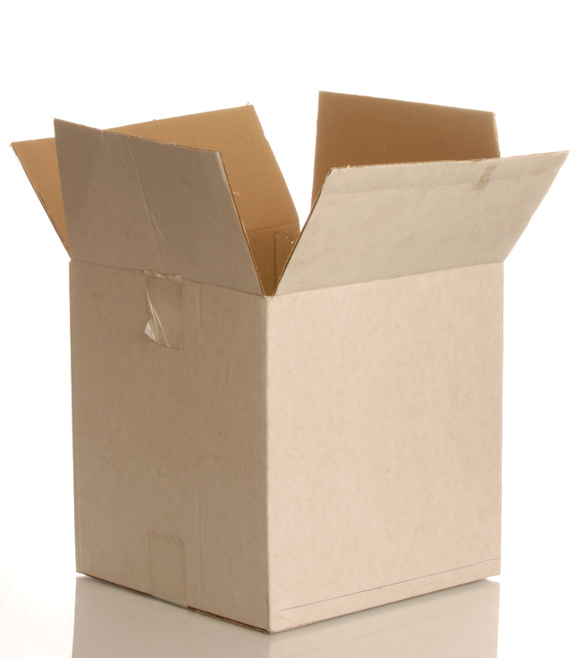
Delivery Options and Costs
One, Two or Four Deliveries/Month
– No charge
Multiple Site Deliveries
– No charge
Notes:
Let’s talk about delivery options and the cost associated with that option.

Slide 33
Looking Ahead: Important Events for SY 18-19
January – March 2018:
On Demand Ordering Survey
USDA Foods
USDA Foods Direct Diversion Survey
Department of Defense Fresh Fruit and Vegetable Program Survey
March – April 2018:
Sponsors update “closed dates”, delivery locations and delivery preference information for Ohio Department of Education.
Notes:
Starting the next school year:

Slide 34
Looking Ahead: Important Events for SY 18-19
July 2018 – April 2019:
USDA Foods ordering through CATS
August 2018 – May 2019:
USDA Foods delivery to participants

Slide 35
education.ohio.gov
Office for Child Nutrition
25 S. Front Street, Mail Stop 303
Columbus, OH 43215
Fax: (614) 466-8505
Phone: (614) 466-2945
Christine.Farmer@education.ohio.gov
Holly.Prater@education.ohio.gov

Slide 36
Join the Conversation
OHEducation
@OHEducation
@OHEducationSupt
OHEducation
OhioEdDept
education.ohio.gov/text
Notes:
Did you hear the news? We’re now on Instagram! Check out our official account and follow us at instagram.com/OHEducation. There, you can keep up with top news and updates and, this fall, be on the lookout for fun connections with Ohio teachers in their classrooms.
You also can stay up to date by following our other social media channels. In addition to Instagram, connect with us on Facebook, Twitter, and YouTube. Our handles are on the slide.
Superintendent of Public Instruction Paolo DeMaria even has his own Twitter account. Follow him @OHEducationSupt.
Get text updates delivered directly to your phone! Go to education.ohio.gov/text to subscribe.

