Slide 1

Student Readiness Toolkit for Math
June 2020

Slide 2

Goal
Introduce a process using documents in the Student Readiness Toolkit to support student learning for the 2020-2021 school year.
Notes:
The goal of this Math Toolkit is to introduce a process using documents in the Toolkit to support student learning for the 2020-2021 school year.

Slide 3

Student Readiness/Teacher Preparedness
Each year students come to school excited to learn. Next year will be no different! Plan to provide engaging math experiences that promote development of mathematical understanding and success for all students.
Review mathematical goals for typical instruction,
Compare to student instructional opportunities,
Pre-assess then adjust instruction to allow all students access to growing mathematically.
Being knowledgeable and prepared helps instruction to best meet the academic, social and emotional needs of each student.
Notes:
Each year students come to school excited to learn. Next year will be no different! Plan to provide engaging math experiences that promote development of mathematical understanding and success for all students. Review mathematical goals for typical instruction, compare to student instructional opportunities, pre-assess then adjust instruction to allow all students access to growing mathematically. Being knowledgeable and prepared helps instruction to best meet the academic, social and emotional needs of each student.

Slide 4

Math Tools
Gap Analysis
Learning Progressions
Critical Areas of Focus
Model Curriculum
Preparing for Instruction
Released Items
Notes:
These documents, Gap Analysis Learning Progressions, Critical Areas of Focus Model Curriculum, Preparing for Instruction and the Released Items, used together will promote an understanding of the mathematical expectations in comparison to the readiness of students. All are contained in the Toolkit and also on the Math Standards web page.

Slide 5

Gap Analysis
Flexible Excel documents
Mathematics standards
Sortable by grade or course
Complete electronically or paper/pencil
Notes:
The Gap Analysis is a series of
Flexible Excel documents of the mathematics standards sortable by grade or course
They can be completed electronically or paper/pencil, by individual teachers or by groups of teachers who all taught the same grade or course by entering individual names paired with the course in each cell.

Slide 6

Gap Analysis Goals
To create a class record of the learning opportunities students had during 2019-2020.
To provide 2020-2021 teachers with information on what and when instruction was received.
Notes:
The Gap Analysis creates a class record of learning opportunities and provides teachers with information about that instruction. It allows for communication between 19-20 school year teachers and the 20-21 school year teachers. Honest recording of what was taught and when it was taught will assist the next teacher in identifying where learning may be weak or absent.

Slide 7
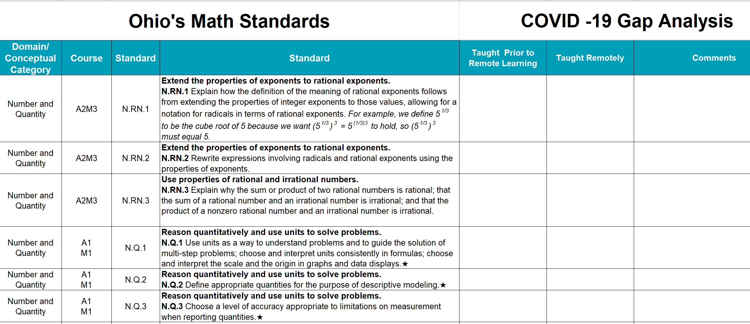
Gap Analysis
HIGH SCHOOL
Course Code Column
Notes:
This is a HS example of the Gap Analysis. The high school worksheet has an extra column to denote recommended course alignment allowing sorting by course.
When distributed to the upcoming teacher, that teacher can sort their section based upon desirable factors – for example, by the previous teacher, taught remotely, not taught

Slide 8
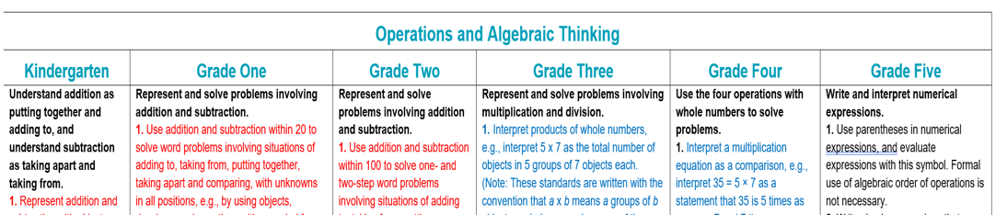
Learning Progressions K-5
A&S red
M&D blue
No. black
Color-coded to reflect the progression of a mathematical area across K-5 relating standards from different domains
Highlights possible areas of strength or weakness when connected to Gap Analysis information
Notes:
This K-5 learning progressions document has been color-coded from the K-8 Learning Progressions to reflect the progression of a mathematical area.
Each of these mathematical areas covers a multi-grade span, includes standards from different domains and increases the mathematical understanding over time.
The main mathematical areas are:
Addition and Subtraction red
Multiplication and Division blue
Number and Place Value black
Geometry brown

Slide 9

Critical Areas of Focus K-12
Identify related standards with explanations of the overall mathematical understanding that is to be developed
Reveals when alterations may need to be made to typical instruction to maximize learning for all students.
Notes:
The CAF documents from each grade and high school course identify related standards with explanations of the overall mathematical understanding that is to be developed. Using these documents along with the Gap Analysis and when applicable the Learning Progressions allows a teacher to determine when alterations may need to be made to typical instruction to maximize learning for all students.

Slide 10

Put It Together
Learning Progressions and/or
Critical Areas of Focus
Gap Analysis
=
+
Notes:
By connecting the data in the Gap Analysis to the Learning Progressions or Critical Areas of Focus, areas of strength or weakness will be brought to light.
Designing instruction around these areas should allow for more time to be spent on critical learning as related areas are addressed together.
The more instructional strategies include a focus on the mathematical practices, the more bang for the buck!
Providing tasks involving numbers that reveal the mathematical understanding will allow access for more students to be engaged and to develop that desired mathematical understanding.
Breaking learning into small steps allows student understanding to develop, which opens the doors for transference to other areas.
The greater the emphasis on developing reasoning and communication skills the better the results.
All students can learn mathematics when given the opportunity.

Slide 11
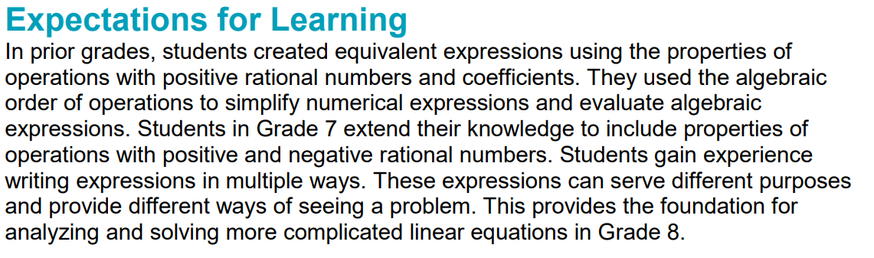
Model Curriculum GRADE 7
Adds further guidance about the connections of previous learning and the instructional focus.
Notes:
The Expectations for Learning portion of the Model Curriculum illuminates connections of previous learning to current learning with implications for future learning.

Slide 12

Local Curriculum
Look for lessons that exceed the learning expectations for the grade or course; use those as extensions or remove altogether
Review sequence or pacing for ways to better connect to previous learning
Notes:
The local curriculum connects resources, instructional strategies and assessments to the standards
It may also provide pacing and sequence guidance, which may need to be altered next year
Look for lessons that exceed the learning expectations for the grade or course, use those as extensions or remove altogether
Review sequence or pacing for ways to better connect to previous learning

Slide 13

Preparing for Instruction
A series of guiding questions to trigger teacher reflection on previous teaching practices while at the same time considering the likely absence or weakness of previous learning based upon knowledge of the progression of learning in the mathematical area and the documentation in the Gap Analysis.
Notes:
The Preparing for Instruction Document is a series of guiding questions to trigger teacher reflection on previous teaching practices while at the same time considering the likely absence or weakness of previous learning based upon knowledge of the progression of learning in the mathematical area and the documentation in the Gap Analysis.

Slide 14

Assessment Tools
Math Readiness Assessments
Test Specifications
Test Blueprints
Understanding Formative, Interim and Summative Assessments in the Classroom
Item Development Sequence
Roadmap from OST Assessment Development Resources to Classroom Assessment Practices
Notes:
These assessment tools may provide deeper understanding of the learning expectations needed for success on the state tests.

Slide 15
Math Readiness Assessments
Pre-assessments prior to teaching a unit or mathematical area may inform student readiness
Ready to use Grades 3-8 OST released test items coded to Standards, Critical Areas of Focus and Reporting Categories
Teacher scoring information
Notes:
The toolkit provides problems that have been released from previous State tests. Reviewing items from the previous year may provide further ideas of what students should be able to solve. These released items may be used to capture the thinking of students by pre-assessing prior to teaching a unit or mathematical area.

Slide 16
Plan to Engage All Students
Use grade level tasks that
  Highlight and develop mathematical understanding,
  Are engaging and accessible to all students,
  Permit multiple strategies,
  Allow for multiple representations,
  Expect explanations, justifications or critiquing other’s thinking, and
  Encourage mathematical reasoning.
Notes:
Use grade level tasks that
Highlight and develop mathematical understanding,
Are engaging and accessible to all students,
Permit multiple strategies,
Allow for multiple representations,
Expect explanations, justifications or critiquing other’s thinking, and
Encourage mathematical reasoning.

Slide 17
Math Team
Name | Email
Brian Bickley | Brian.Bickley@education.ohio.gov
Anna Cannelongo | Anna.Cannelongo@education.ohio.gov
Ann Carlson | Ann.Carlson@education.ohio.gov
Annika Moore | Annika.Moore@education.ohio.gov
Yelena Palayeva | Yelena.Palayeva@education.ohio.gov
Notes:
Above all, if you need further assistance please contact one of the math consultants.

